Slide 1
Counterfeit Goods and the Public’s Health and Safety: A Study of Interventions
A Joint Project of the US Patent and Trademark Office and Widener School of Law Health Law Institute
Module for Legislators
V3.12.11
The audio will start as each slide opens.

Slide 2
STOP
Pre-Class Assignment? Is it done? If not please do so before starting this course.
First: please read the report in full.
Second: Collect any and all national laws that relate to counterfeiting and conduct an assessment using the course tool.
Project website: www.counterfeitgoodshealth.net
The audio will open as each slide opens.
Notes:
Third: The project website has a place for file sharing. Use the C&C form.
The report, assessment tool and C&C form are located at

Slide 3
Learning Objectives
Learn and understand legislative options and innovations
Understand why data and monitoring and evaluation are important and how and when to mandate these steps.
Evaluate your country system, identify gaps and opportunities, develop a plan of action and begin implementation.
Notes:
NOTE: Insert Assessment Tool for Legislators (the legislators portion does not contain the same slide as regulators or law enforcement where the assessment tool is mentioned beyond the previous page and this one.)

Slide 4
What’s the evidence?
Crime rates 2000-2009
Customs seizure data
Viet Nam - Myanmar study on inspections and counterfeit drugs.
Empirical data: 2010: 25 Country Study
Consensus findings
ICDRA meeting in 2004
WCO SECURE Standards

Slide 5
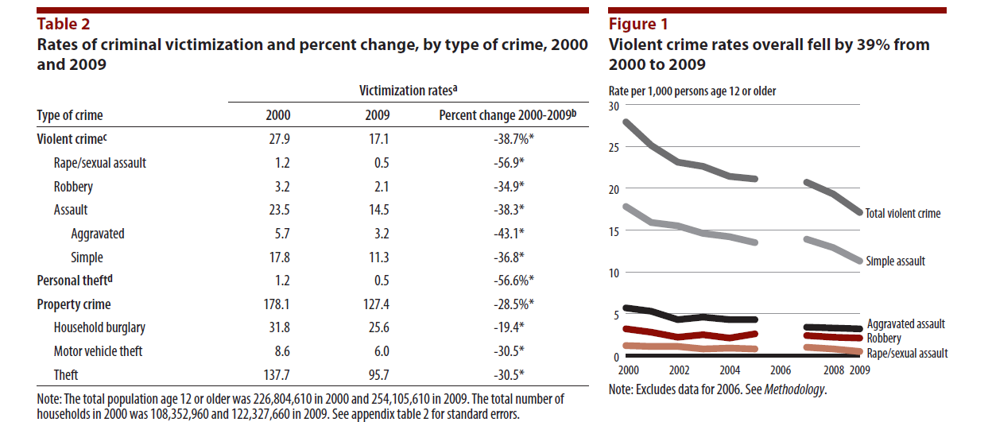
Crime Reports and Seizure Data: What story do they tell?
Notes:
Note to instructor: Insert data slide here for your local audience and discuss this slide.
These two charts show US crime data. I show these to give a sense of what can be done with the data from the two methods used to track crime. Lots of countries use these two methods. They are (1) crimes reported to police and (2) crimes calculate by a household survey. Two methods are used to capture a better reflection of the true extent of crimes because there can be variation in reports to the police./ The survey provides a standardized set of questions and thus standard data is collected. These charts are published in annual crime reports in many countries.
However in the US at least only serious crimes such as murder & non-negligent manslaughter, aggravated assault and the Property crimes of Burglary, Larceny-theft and Motor vehicle theft. Data on Forgery and counterfeiting are not are collected in serious crimes as reported to the police even though serious bodily harm can occur with exposure to a counterfeit.
What would we have to do to improve our data collection on counterfeit crimes? Formulate survey questions to illicit awareness that a crime and related injury may have an associated counterfeit;
For these reports forgery and counterfeiting defined as - The altering, copying, or imitating of something, without authority or right, with the intent to deceive or defraud by passing the copy or thing altered or imitated as that which is original or genuine; or the selling, buying, or possession of an altered, copied, or imitated thing with the intent to deceive or defraud. Attempts are included.
the Uniform Crime Reports and National Crime Victim Survey and in the UK they are called The NCVS UK Recorded Crime - British Crime Survey (BCS).

Slide 6
Just in case you read footnotes
Notes:
Just in case you read footnotes and want them for the prior slide – here they are

Slide 7
Why are crime rates going down?
Governments have more legitimacy and better courts to settle feuds.
Economics
Culture – killing is vulgar
Law enforcement is better and there is more
Better because
Data
Know-how
Better able to place resources where needed
Do these reasons apply to counterfeit crime?
Notes:
So why are crime rates going down? Scholars have offered several explanations for the centuries’-long decline of violence in the West. Here are three common ones:
Government: Political authorities have gained greater policing power and legitimacy that has allowed them to suppress criminal attacks, intergroup battles, and personal feuds. And court systems provide a peaceful way to resolve conflicts.
Economics: Greater and more broadly-distributed wealth reduced people’s motivation for crime and raised the costs of getting into trouble. (Barroom brawling seems less attractive if it will cost you a steady and well-paying job.)
Culture: Over the centuries, westerners increasingly came to feel that violence was uncouth and distasteful. Historians refer to the “civilizing process. Over time, hitting, knifing, and shooting came to seem (to most people) as vulgar.
Law Enforcement is better and there is more of it
more sophisticated policing methods and more resources to respond to any fluctuations in crime rates.
More sophisticated policing due to more sophisticated data. Example NYC
COMPSTAT—(short for COMPuter STATistics or COMParative STATistics) is the name given to the New York City Police Department's accountability process and which has since been replicated in many other departments. CompStat is a organizational management tool for police departments. It is a software package. Instead, CompStat is a multilayered approach to crime reduction and personnel and resource management. It employs Geographic Information Systems to map crime, identify problems, devise strategies and tactics to solve problems.

Slide 8
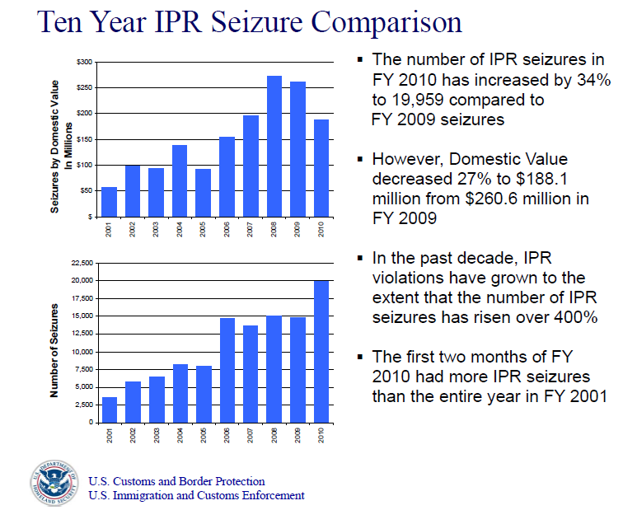
Counterfeit seizures going up
Insert 2010 -2009 seizure charts
Notes:
Note to instructor – insert comparable statistics for your local audience here and discuss this slide.
US report – note Counterfeit Seizures are going up Final Report Jan 2011 of USCBP and ICE.
Number of seizures is up by 34% between 09-10 and yet the dollar value decreased by 27%.

Slide 9
Why?
More enforcement attention
Is it because there are more counterfeits?
Why are these data invalid?
Valid data refers to the extent to which a measure actually represents what we intend to measure.
Other problems with these data?
Crime and seizure data is not precise
Otherwise reliable; has integrity and is timely.
Notes:
Do the data on these two charts mean the number of counterfeit goods has increased or that law enforcement is doing a better job of apprehending counterfeit goods and that is all that is reflected.
1. Validity refers to the extent to which a measure actually represents what we intend to measure. Consider is crime or seizure data valid?
2. Reliability Data should reflect stable and consistent data collection processes and analysis methods over time.
3. Precision Precise data have a sufficient level of detail to present a fair picture of performance and enable management decision-making. Crime and seizure data is not precise.
4. Integrity focuses on whether there is improper manipulation of data.
5. Timeliness Data should be available and up to date enough to meet management needs.
two key aspects of timeliness. First, data must be available frequently enough to influence management decision making. And second close in time to when decisions based on the data will be made
For any product that could affect health an on line data base would be invaluable not only for customs but also to maintain the integrity of the supply chain by aiding in the determination of whether a vendor or supplier has any record. The system used by Export Controls that lists prohibited consignees and has a system to self evaluate whether an export can be completed without specific authorization could be a model for how to build a data base for this purpose. Law enforcement data could be enhanced to include injury status on criminal and civil cases, the names of suspicious suppliers, countries of origin, and the like. At present there is likely a substantial data in the hands of law enforcement that is not mined for useful information.

Slide 10
Inspection and quality control on country level improves drug quality
Viet Nam- Myanmar study of inspections and counterfeit drugs. (WHO/EDP/QSM/99.3).
Notes:
This study clearly demonstrates how important inspections are – pure manpower presence alone blocks counterfeits from circulating.
More inspectors and inspections: fewer counterfeit drugs moving into the market
Viet Nam- Myanmar study of inspections and counterfeit drugs. (WHO/EDP/QSM/99.3)

Slide 11
Why was this study so important?
Many methods to collect data but for impact evaluations, experimental methods generate the strongest evidence.
Notes:
No single method is privileged over others; rather, the selection of method or methods for a particular evaluation should principally consider the empirical strength of study design as well as the feasibility.
For impact evaluations, experimental methods generate the strongest evidence. Alternative methods should be utilized only when random assignment strategies are infeasible. There are basic steps to an experimental study design.
Notes to Instructor: In case there are questions on experimental design. Here are basic steps.
• Establishment of team with the appropriate methodological and subject matter expertise to conduct an excellent evaluation.
• Written design, including identification of key question(s), methods, main features of data collection instruments, data analysis plans, and dissemination plan.
• Use of data collection and analytic methods that ensure, to the maximum extent possible, that if a different, well-qualified evaluator were to undertake the same evaluation, he or she would arrive at the same or similar findings and conclusions.
• Application and use to the maximum extent possible of social science methods and tools that reduce the need for evaluator-specific judgments.
• Standardized recording and maintenance of records from the evaluation (e.g., focus group transcripts).
• Evaluation findings that are based on facts, evidence and data. This precludes relying exclusively upon anecdotes, hearsay and unverified opinions. Findings should be specific, concise and supported by quantitative and qualitative information that is reliable, valid and generalizable.
• Evaluation reports that include the original scope of work, a full description of methodology (or methodologies) used, as well as the limitations in the inferences that can be drawn. Readers should have sufficient information about the body of evidence and how information was gathered to make a judgment as to its reliability, validity and generalizability.
• Evaluation reports that include action-oriented, practical and specific recommendations assigning or designating the implementer.
• Adequate budget and timeline for a high quality evaluation.

Slide 12
Notes:
Empirical Findings confirm the directions legislators took in the last ten years. From Annex 5 of report
Findings are
In this 25 country study – that regulators wanted more specific legislation that empowered them to fight counterfeit medicines
To criminalize behaviors around counterfeit medical products
Laws to control drug trade done within FTZs
They noted weak cooperation between police, customs and themselves and blamed the lack of a legal framework for this
The wanted more joint efforts between ministries
And a single point of contact to facilitate information sharing.

Slide 13
Consensus Findings
ICDRA
2004: take steps to a convention
Elements
Enhanced regulatory authority
Single point of contact
Regulation of the supply chain: Enforce GMP
Code of good practice for inspections
Adoption of a uniform definition
Establish offenses and increase sanctions
Cooperate – data and information
WCO SECURE Standards
2007-2008
Elements
Legal authority and mandates
Procedures
Central point of contact for IPR enforcement
Risk Analysis
Compile/share statistical data - birth of CEN
Targeted enforcement teams
Capacity building; e-learning
Partnerships
Cooperation
Notes:
ICDRA voted to raise awareness, exchange data and draft a concept paper for a convention
Customs to have legal authority in terms of imports, exports, transit, warehouses, tran-shipment, free zones, free ports, postal shipments, goods ordered via the internet
Despite the opposition to the SECURE standards – by public healthy activists that the standards are TRIPS+, the status of the standards is unclear after 2008 – I think many of the elements are otherwise integrated into WCO strategy.

Slide 14
Have legislators met the needs of regulators and law enforcement?
International, regional, national changes
Legislators have been busy!
Focus
Defining counterfeit goods in general and separately for medical products
Law Enforcement measures
Criminal laws – punitive measures
Customs
Standards
Notes:
Since 2000 there has been a significant number and variety international, regional and local legislative initiatives to combat counterfeits. Initiatives have focused on law enforcement measures and counterfeit medicines, adding centralized offices to address counterfeits and inspectors with powers, clarifying the nature of a counterfeit offense and amplifying sanctions for violators.

Slide 15
International - Anti-Counterfeiting Trade Agreement – ACTA
If ACTA adopted or elements in other legislation
Parts of ACTA support health
Only to IP rights
Burden of proof
Commercial scale defined
Parts of ACTA that can be refined to protect health
Recognize society as a participant
Proportionality
Mandate destruction/no return to commerce
Expedited process/consignee compensation
Ex officio
Notes:
Now we turn our attention to the variety of legislative interventions from the past ten years.
Plurilateral law enforcement model
Implementation by signatories

Slide 16
Regional Activities
East Africa Community (EAC) 2009-2010
Kenya, Tanzania, Uganda, Zambia
Annex 3 – side by side comparison
Innovations
Comprehensive body of rules
An agency, board, department, point person
New scope – dual and three prong definitions
All actions illegal or criminal
Appoint inspectors and grant powers
Example is the EU Medicrime Convention
Notes:
Recall what regulators said in 2010 study.

Slide 17
Definition
Uganda – dual definition
Without authority
Adds WHO definition of counterfeit medicine
Tanzania – crime of counterfeiting
Refers to health and safety
Zambia distinguishes counterfeits from generic medicines
Kenya – enumerates all activities if w/out authority
manufacture, production, packaging, re-packaging, labeling or making, whether in Kenya or elsewhere
Includes any and all products
India extends IP protection to actual products
India – pharmaceuticals and agrochemicals
Notes:
Uganda uses the general definition of without authority and adds a special definition for counterfeit medicines based on one used within the WHO for the last 20 or more years: In the case of medicines, includes the deliberate and fraudulent mislabeling of medicines with respect to identity or source, whether or not such products have correct ingredients, wrong ingredients, have sufficient active ingredients or have fake packaging.
Kenya - refers to any product – no special reference to health and safety products
manufacture, production, packaging, re-packaging, labeling or making, whether in Kenya or elsewhere, of any goods whereby those protected goods are imitated in such manner and:
to such a degree that those other goods are identical or substantially similar copies of the protected goods;
or
(b) … the other goods are calculated to be confused with or to be taken as being the protected goods of the said owner or any goods manufactured, produced or made under his license;

Slide 18
Inspectors and Powers
Focus on inspectors and inspection
Forms and procedures
All inspectors are counterfeit inspectors
Customs, seed, plants, public health, transportation - all sectors
Dual appointments
All responsible under new law

Slide 19
EU Medicrime Convention 2010
Counterfeit, and illegal and/or substandard
Medical product with IP rights or not
False representation of identity or source
Used for humans and veterinary use
Whether generic or not, excipients, API, devices, finished
Start to finish: manufacture, supply, labels, package, storage, transport
Cooperation within and between law enforcement and other agencies
Prevention, and victim/witness protection
Central monitoring body
See also Singapore – early adopter
Notes:
This convention governs counterfeit, substandard and unregistered medicines. In line with best practices, the Convention provides a framework for national and international co-operation and coordination across and between government agencies. It adds preventive measures and provides for protection of victims and witnesses, a monitoring body a central information point to oversee the implementation of the Convention by the States Parties.
Finally, the scope of the Convention settles the debate over whether use of the term “counterfeit” places too heavy an emphasis on the IP aspects rather than the public health aspects of the matter by stating it is applicable to medical products as defined whether a product is subject to an IP right or not, provides a non-IP definition of counterfeit as a false representation as regards identity of source and whether generic or not.
The Convention is innovative in several ways. Medical products are defined in Article 4 as medicines for humans and veterinary use. The addition of veterinary products to this act is very important as good health relies on safe food sources, which are constituted in large part by animal meats and dairy. Specifically included in the Convention are excipients, active substances and medical devices. In addition, accessories, documents, parts and materials fall within the Convention’s scope. Even the term victim now includes the natural person who suffers as a result of exposure to a counterfeit, substandard or unregistered product. Thus, the Convention directly demonstrates the concept that actual harm is cause for criminal action.
The Convention adopts nearly universal jurisdiction in Art.10 as it expands the jurisdiction of Member States to locations where acts are committed by Member nationals. The illegal activities typically seen in relation to counterfeits are made criminal under the Convention including warehousing or keeping in stock and exporting counterfeit medicinal products.
The Convention also incorporates new prevention measures. The regulatory measures mandated by the Convention calls for Members to establish quality and safety requirements for medical products. It also requires Members to legislate safe distribution (supply chain management). In addition to these mandates, it calls for members to take measures to train healthcare professionals, promote awareness campaigns to the public, and implement methods of preventing illegal supply of counterfeit medicinal products. Members are committed to integrate measures for prevention and combating counterfeits into development assistance programs. Victims are now accorded care, compensation, witness protection, and access to information about any criminal proceedings in which the perpetrator of their injury is involved.[1]
4.8.4 Singapore – a case study in counterfeit medicine-specific legislation
As early as 2007, Singapore had taken the same approach as the Medicrime Convention and amended its Health Products Act. The amendments include specific provisions for counterfeits, criminal and civil penalties for supply of same and include unregistered and poor quality products.[2] Health products are defined by a schedule and include pharmaceuticals, medical devices and cosmetics. Some key provisions of the Act include prohibiting the supply of health products unless registered and fines up to$100,000 and prison up to 3 years for the knowing supply of adulterated, counterfeit, or tampered with health products. Singapore MOH is the first MOH to cooperate with INTERPOL to combat counterfeits.
[1] Id.
[2] Health Products Act 2007. (2007). Retrieved January 11, 2011 from http://statutes.agc.gov.sg/non_version/cgi-bin/cgi_legdisp.pl?actno=2008-REVED-122D&date=20100215&method=whole&doctitle= Health Products Act 2007.

Slide 20
National
Prioritizing Resources
Crimes and Sanctions
Standards – food and toys
Customs
Technology and the Internet

Slide 21
Prioritizing Resources
A national strategic law enforcement plan
identify structural weaknesses;
share information across departments;
strengthen other countries;
develop int’l standards and enforcement policies;
work with other countries to crack down;
add enhanced penalties for IP violations;
mandate evaluation; and
IP Czar.
Notes:
a national strategic law enforcement plan to address counterfeits by identifying structural weaknesses in the current system; ensuring information sharing across departments; strengthening the ability of other countries to protect and enforce intellectual property rights; working with other countries to develop international standards and enforcement policies; and protecting intellectual property rights overseas by working with other countries to crack down on the sale and trafficking of counterfeit goods. A work plan was issued in 2010. In addition the act enhanced penalties for IP violations. The act mandates the US Government Accountability Office to evaluate the effectiveness of the work of the IPEC in combating counterfeit.
IP CZAR Brazil 2004, US 2008,

Slide 22
Crimes and Sanctions
Crimes
Trafficking in labels and packaging with knowledge
Manufacture, storage
Sanctions
Raising base level offense if conscious or reckless disregard to serious bodily injury
More jail time
Specific penalties for counterfeit drugs
Now serious gravity crimes
Death sentence for counterfeits that cause death
Corporate manslaughter
If gross breach of duty of care
Or actions contribute to fatal incident
Increased penalties spurious or adulterated products

Slide 23
Standards
Regulatory principles that can be adapted to context and used in:
Supply chain management
Place burden on supplier
To perform supplier verification
Provide certificate of compliance with standards based on risk criteria and principles
Grant powers to regulators
Mandatory recall authority
Power to block imports from facilities that refuse inspection
Assessment procedures
Notes:
Food Safety Modernization Act
EU Toy Standards
Applied to foods and toys

Slide 24
Customs, Technology and Internet
Customs; unions and authority to act
Add to list of prohibited and restricted goods
Grant broader jurisdiction, discretion – ex officio authority
Technology
Bar codes with serialization 1st, 2nd , 3rd level packaging
File copy of C of A and retain samples for later testing/reference
Internet
Limit ISP liability
Notes:
Customs
Add counterfeits to list of prohibited and restricted goods
Grant customs authorities broader jurisdiction and discretion – ex officio authority
Join customs unions
Combine trademark registries

Slide 25
Legislative Recommendations
1. Empower regulators and law enforcement
To act against SIC products:
Substandard, illegal or counterfeit product of any type
If the item can harm humans, animals or plants
Include packaging, labeling, all components from starters to finished product, manufacturing equipment and tools
Set safety standards and adopt int’l regulatory principles
Health and safety always trumps status of FTZ

Slide 26
Recommendations
2. Make all inspectors counterfeit inspectors
Administrative detention
Ex officio authority
Common information platform and allow access across agencies
3. Create counterfeit crimes and sanctions
4. Centralize and coordinate roles
Focal points
Inter-ministerial cooperation - clear lines of authority and International cooperation- adopt uniform data fields
5. Mandate safe destruction

Slide 27
Class Project
Review your assessment findings.
Set goals: Identify the opportunities to amend or modify existing laws or add new provisions.
Formulate a plan of action
Outline legislative objectives and amendments.
Set timeline, budget, and assign personnel
Identify indicators
Draft and enact relevant legislation.
Monitor and evaluate your progress!
Please send your plans to the project website and progress updates.
and refine as necessary.
Notes:
Questions to consider:
What are the overlaps, intersections, areas for collaboration? Have you identified the boundaries of your responsibility? Has any area been overlooked?

Slide 28
In closing
Q & A
If you are a solo listener please use Comments and Contributions for Q&A.
Please fill out the Course Evaluation
http://www.surveymonkey.com/s/2K69SCB
Thank you and good wishes.
Notes:
In closing we have learned much about counterfeits but need to know more and do more.

